Slide 1

SERVICE PRO
Presented By:
Ankit Poudyal
Sajit Gurung
Nabin Adhikari
Notes:
Illustration: <a href="https://www.freepik.com/free-photos-vectors/data">Data vector created by stories - www.freepik.com</a>

Slide 2
INTRODUCTION
"Service Pro," is a comprehensive service provider app design to streamline service delivery through our platform.
Providers apply for user-selected services, enabling a seamless match and mutually beneficial service delivery
The service user application empowers individuals to easily find and book qualified providers for their service needs.

Slide 3

Purpose/Objective Of Service Pro
To enable secure, seamless service bookings between users and qualified providers.
To enable users to seamlessly book services from home for efficient and convenient access.

Slide 4
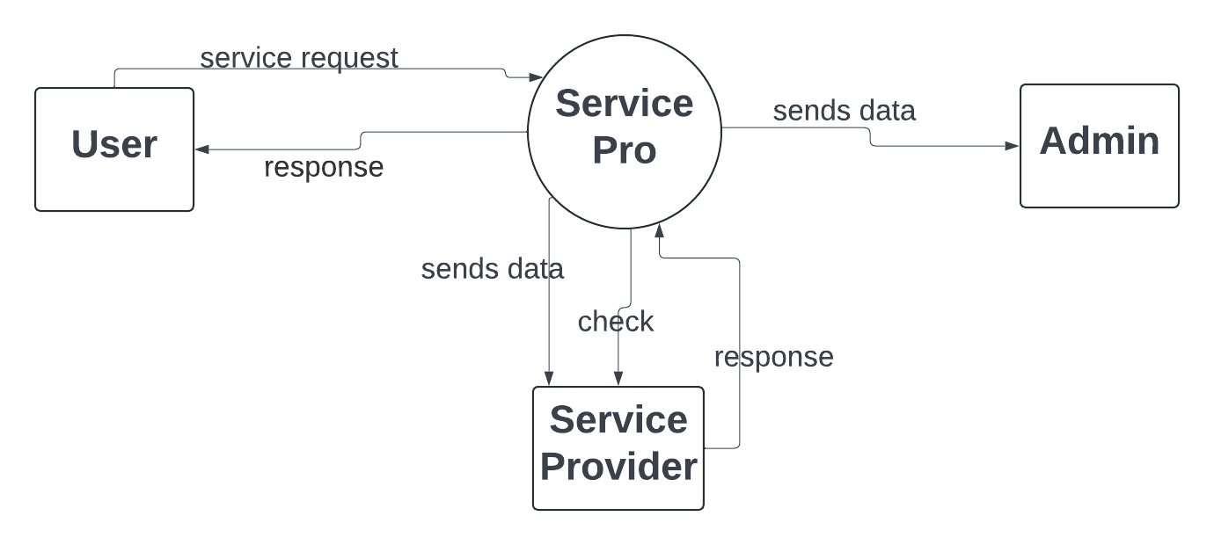
CONTEXT LEVEL DFD

Slide 5
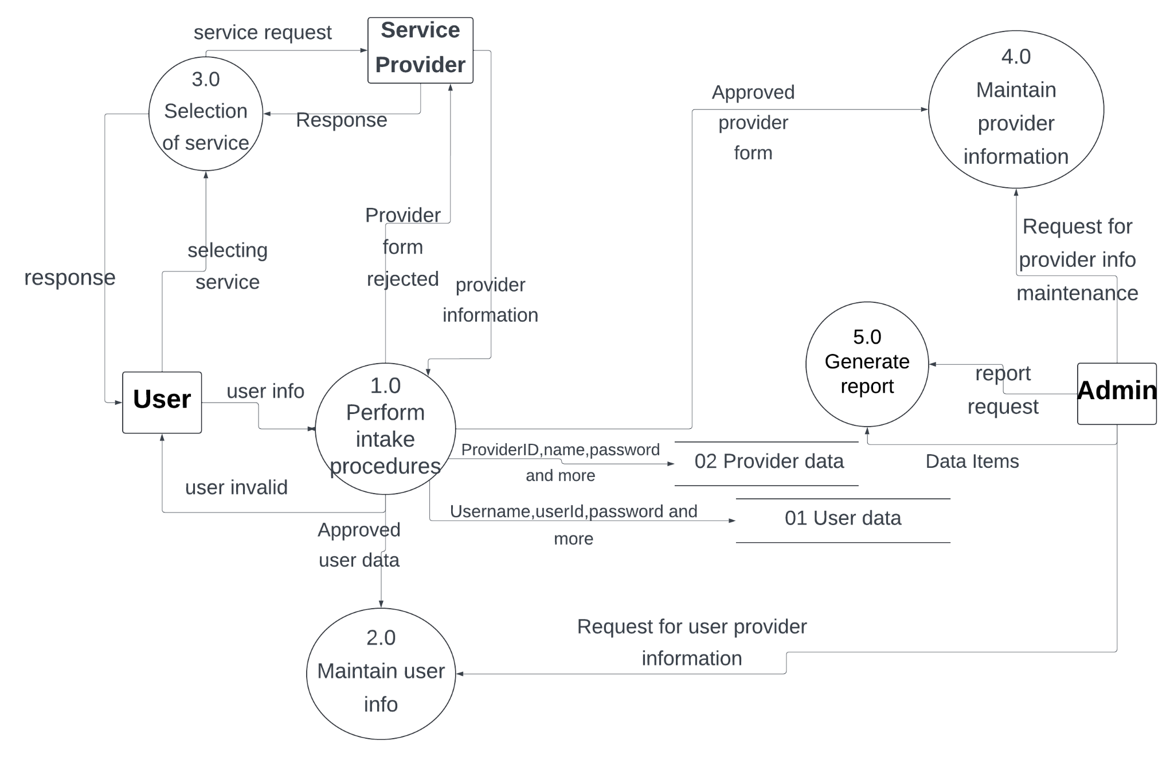
DFD LEVEL 2

Slide 6
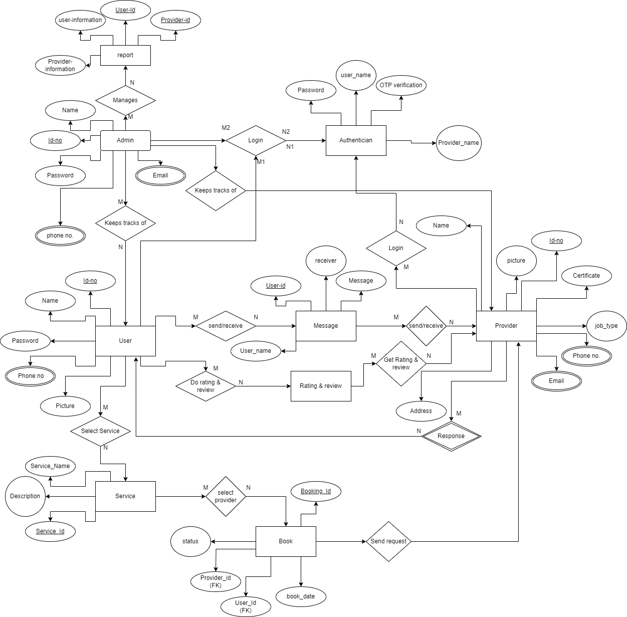
ERD

Slide 7
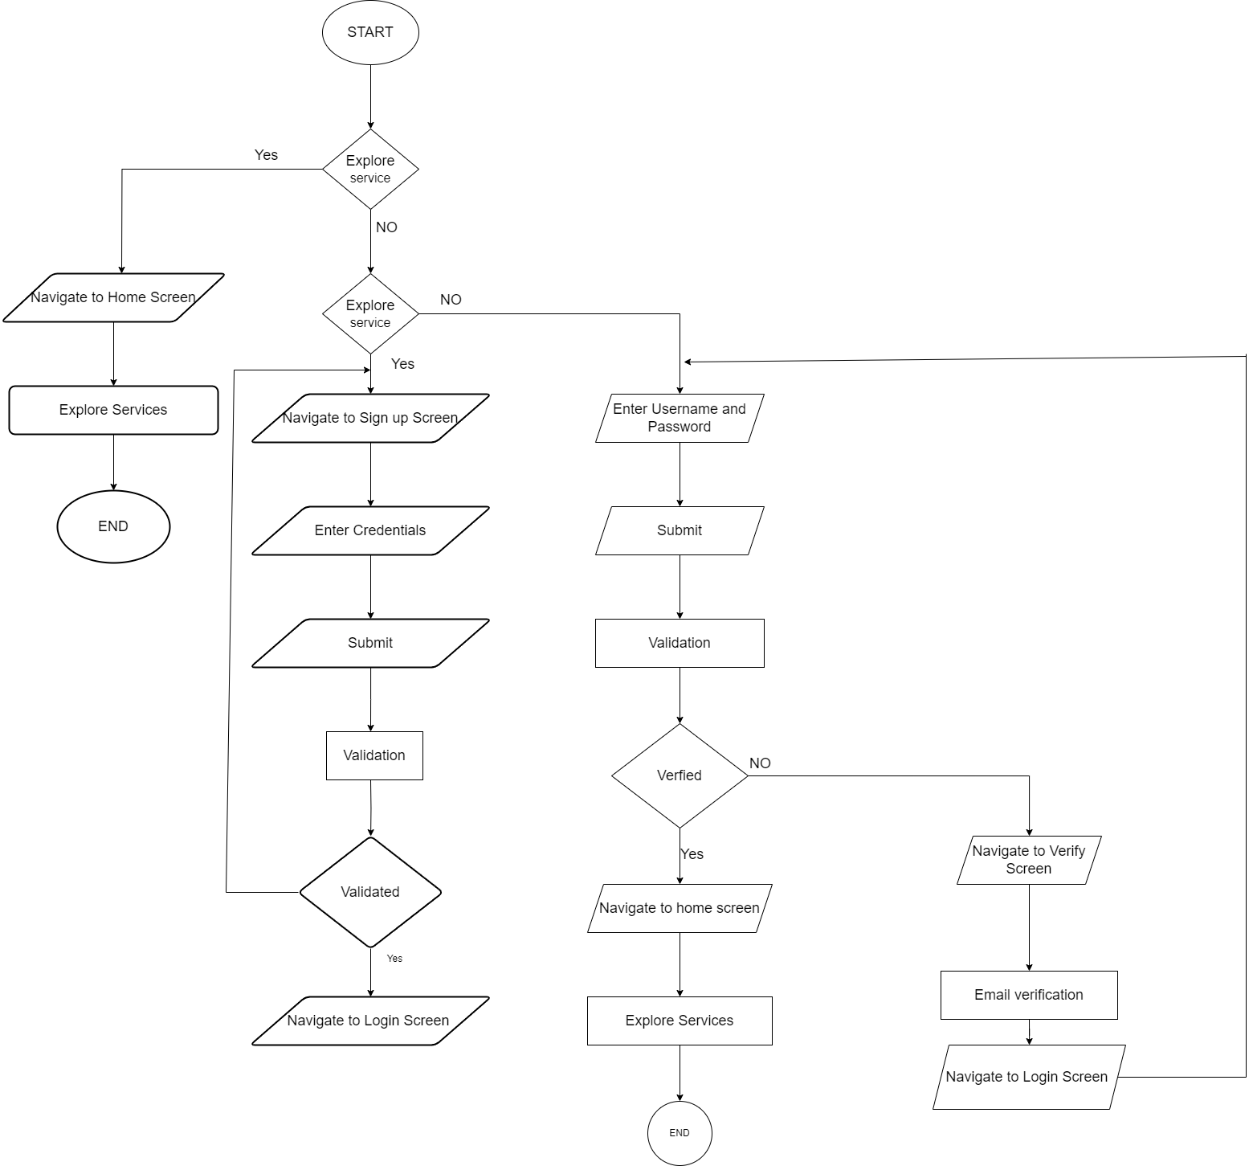
FLOWCHART
i.USER LOGIN

Slide 8
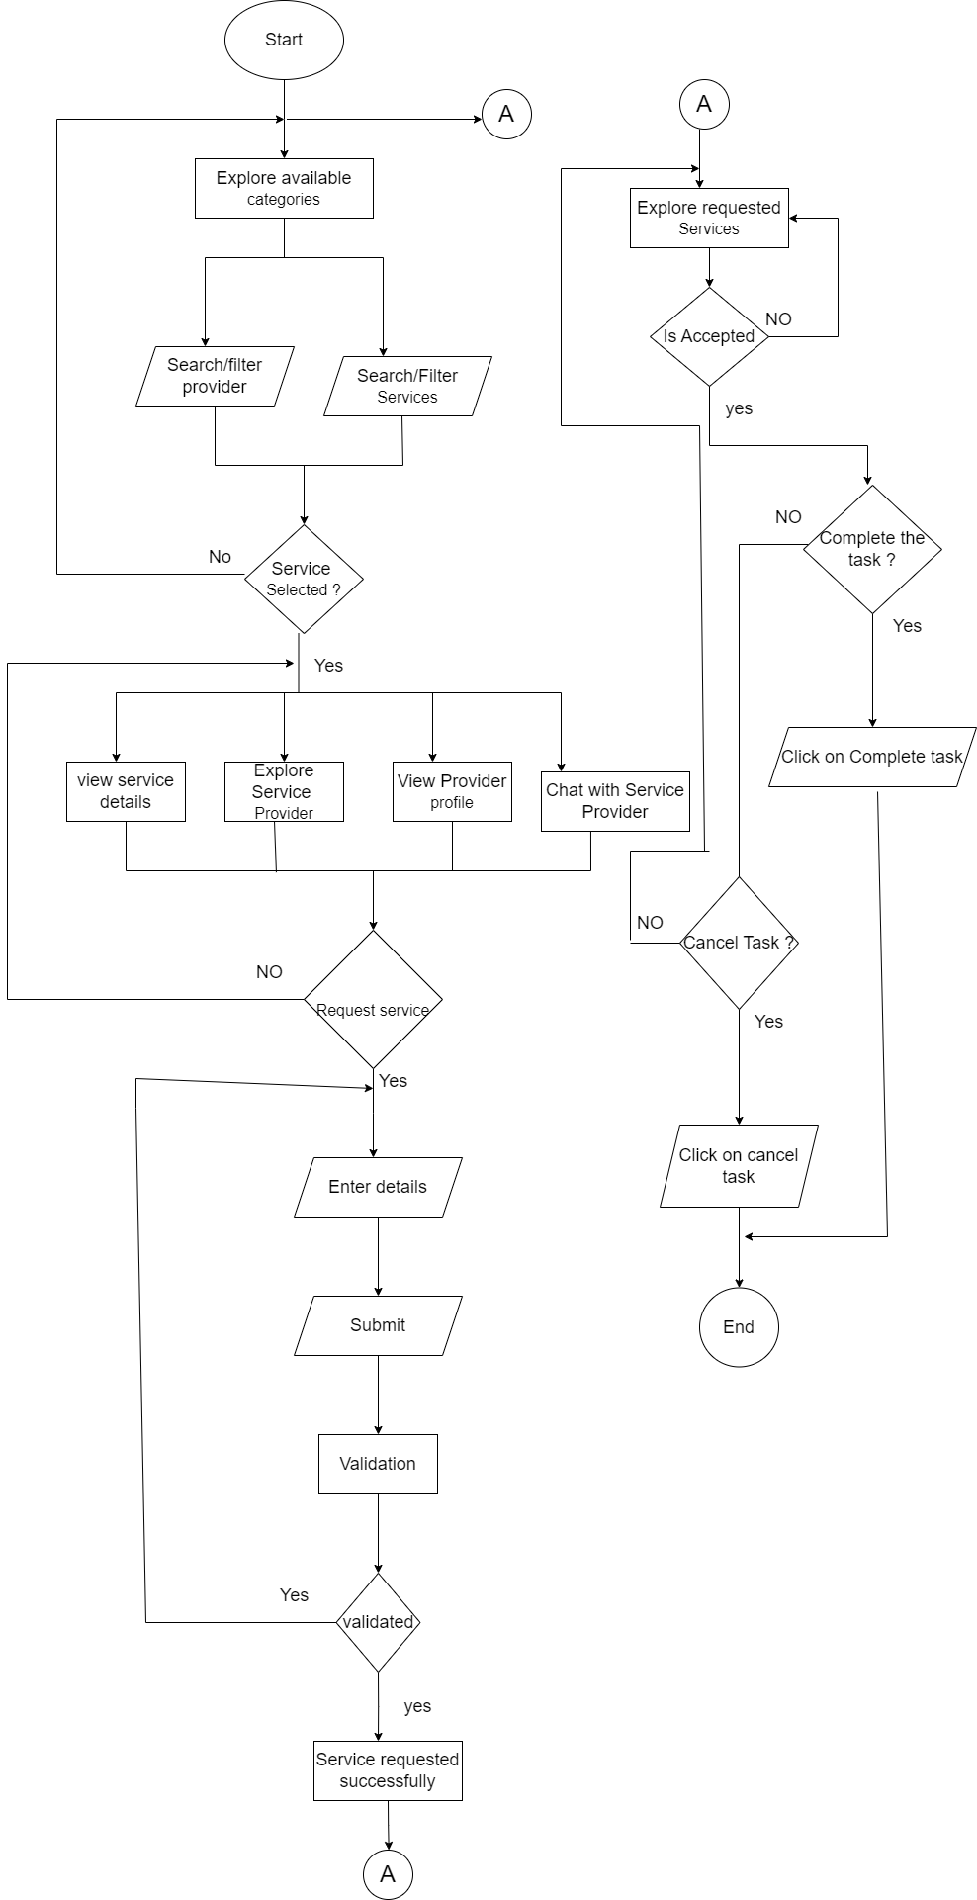
ii.USER

Slide 9
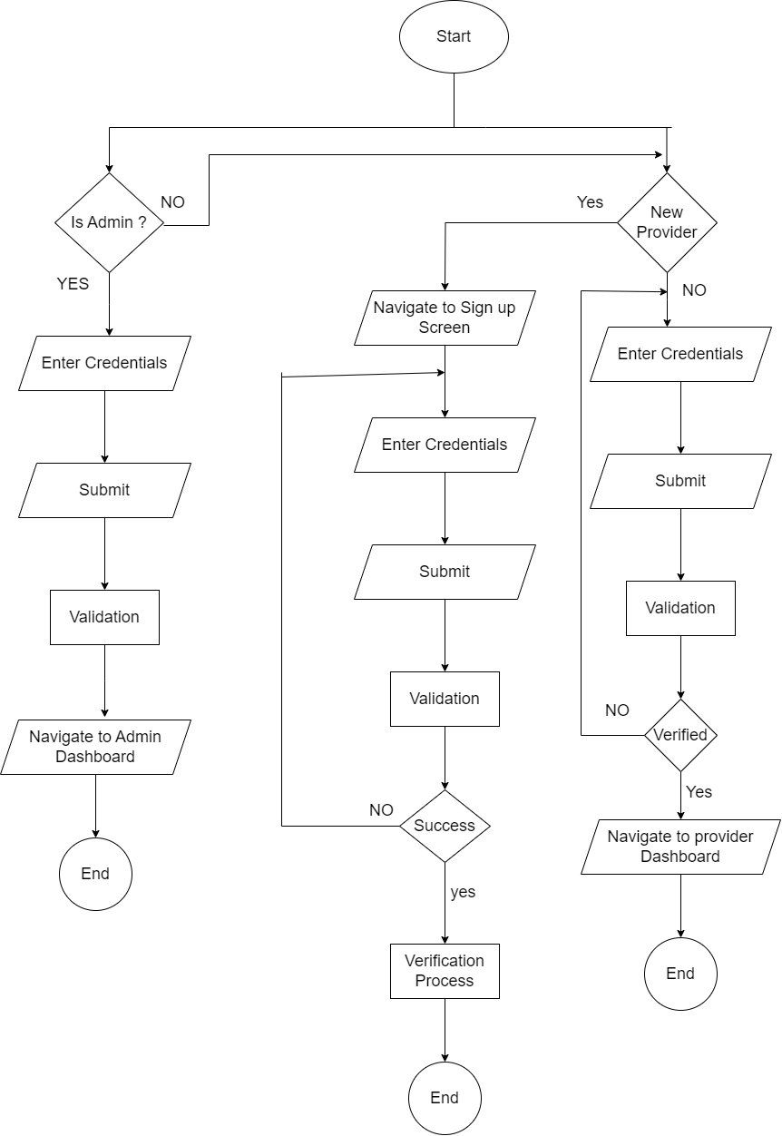
PROVIDER LOGIN

Slide 10
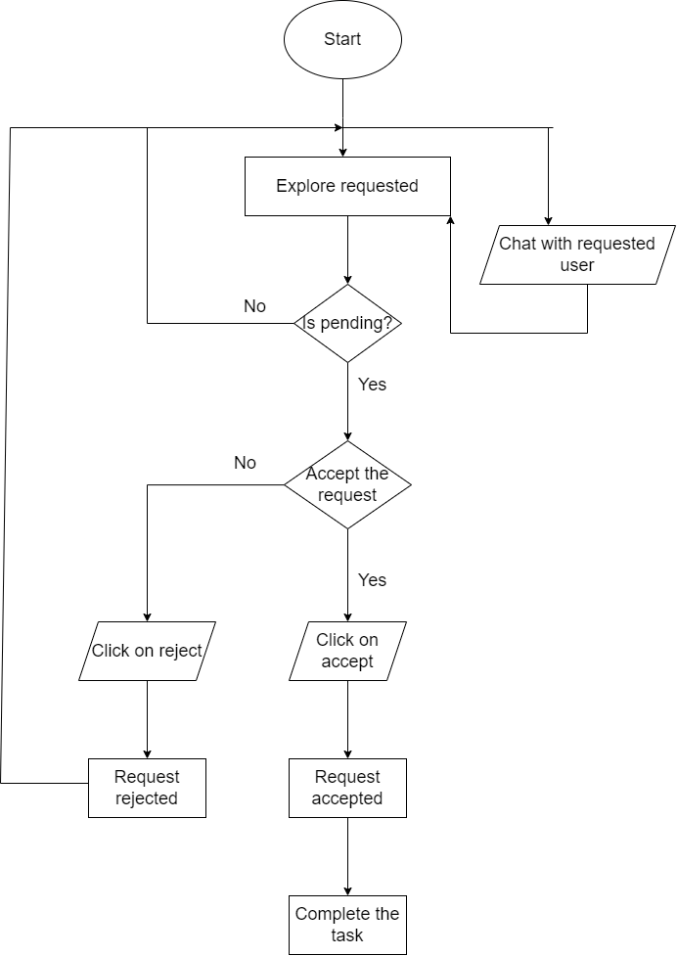
PROVIDER

Slide 11
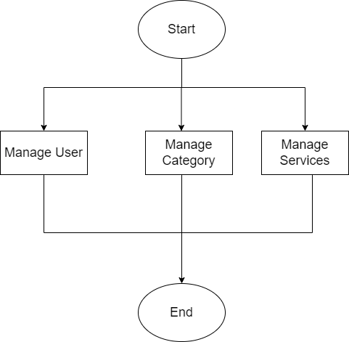
ADMIN

Slide 12
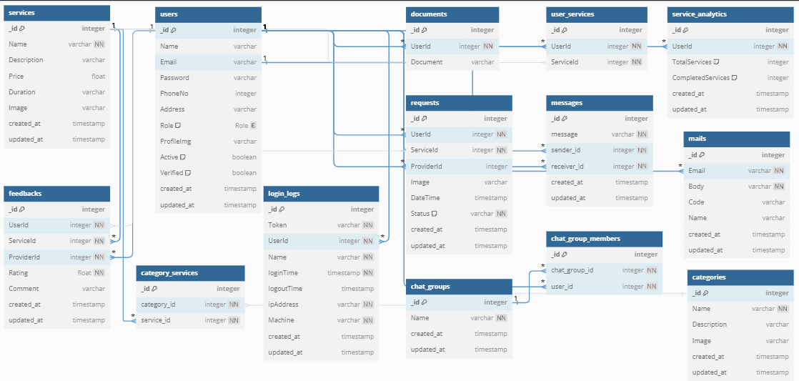
DATABASE SCHEMA

Slide 13
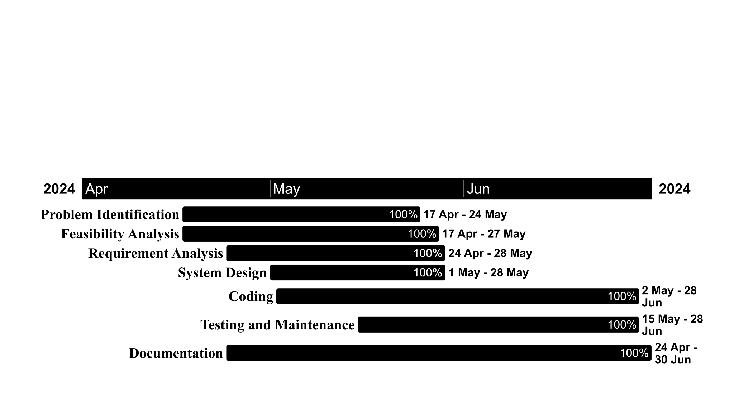
GANTT CHART

Slide 14
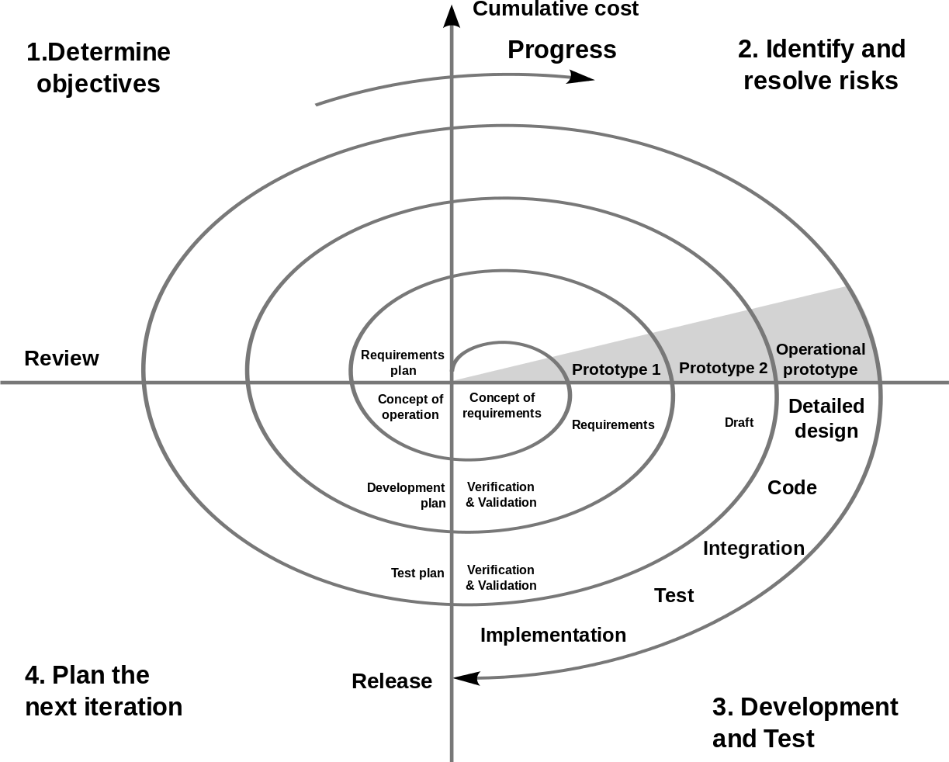
DEVELOPMENT
-SPIRAL MODEL

Slide 15
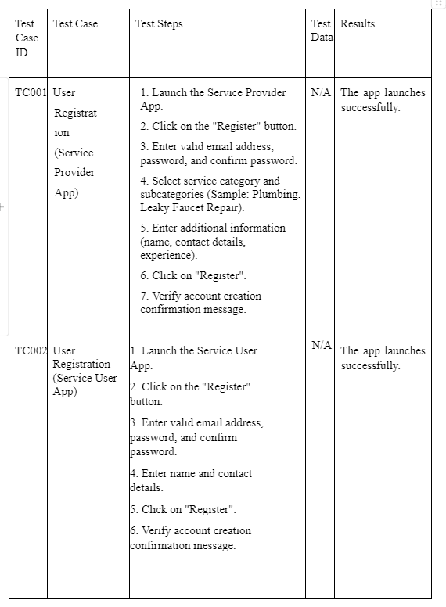
TESTING

Slide 16
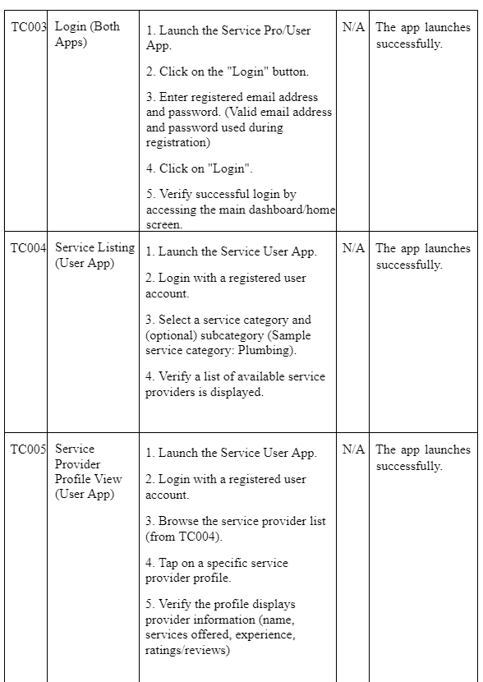

Slide 17
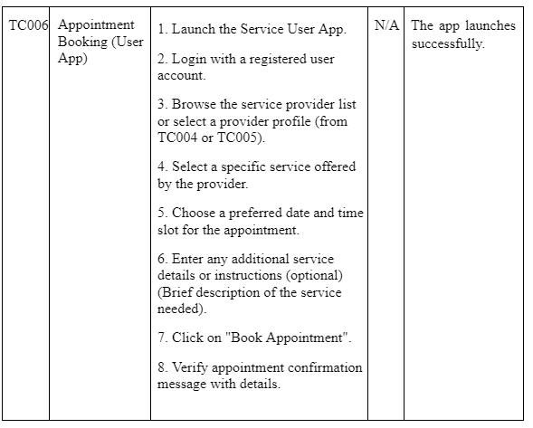

Slide 18
Conclusion
It addresses challenges faced by providers and users in efficiently accessing and offering services
The platform empowers both parties by facilitating seamless communication and a collaborative environment
"Service Pro" is an innovative platform that streamlines service provision through cutting-edge mobile technologies
"Service Pro" aims to redefine service provision by promoting transparency, reliability, and user satisfaction through robust features

Slide 19
Thank
You

